Slide 2
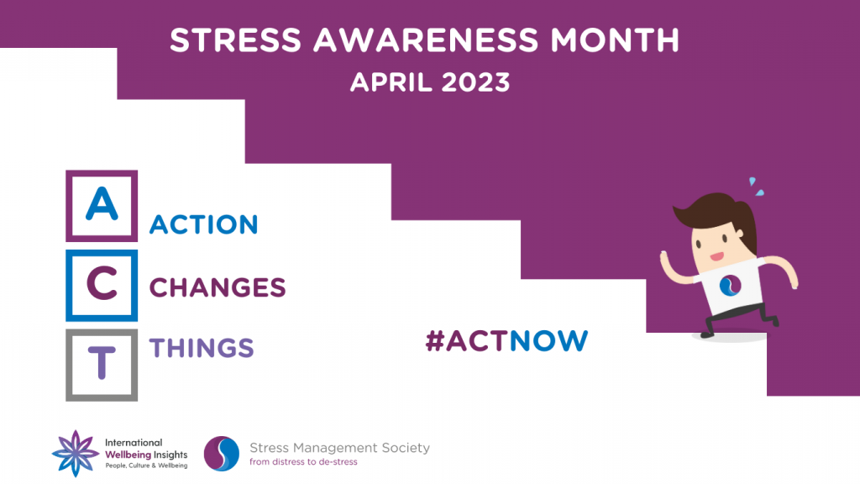
https://www.stress.org.uk/
Info taken from the Stress Management Society

Slide 3
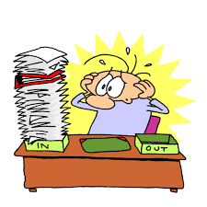
Stress Awareness Month 2023
Stress Awareness Month has been held every April since 1992 to raise awareness of the causes and cures for our modern-day stress epidemic.

Slide 4
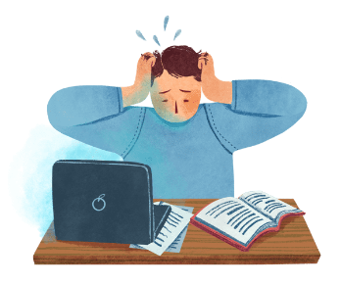
How it affects us
There will be changes in the stressed person.
These changes may be emotional, physical or behavioural, or a combination of all three. So, the key thing is to look out for negative changes of any kind. Bear in mind that the negative changes are also likely to have knock-on effects e.g. reduced performance at work.

Slide 5
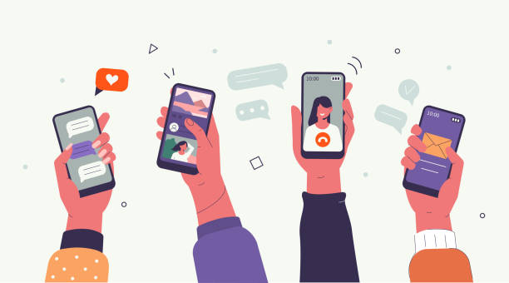
Don’t be a Slave to Tech
Apparently us Britons are now so addicted to our smartphones that we check them every 12 minutes. The constant interruptions that technology can bring to our life, inevitably is starting to take a toll on our wellbeing and our relationships.
According to a report by Ofcom we now spend on average 24 hours a week online, which is twice as long as 10 years ago. Plus one in five of all adults spend as much as 40 hours a week on the web.

Slide 6
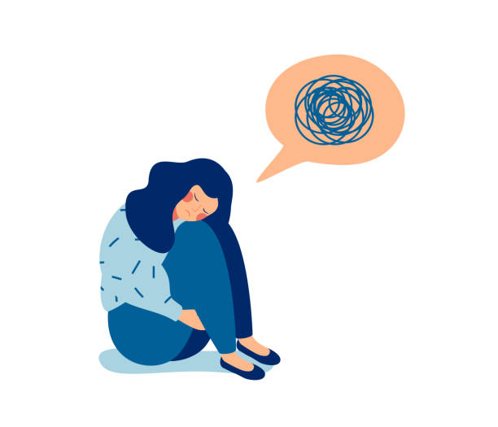
Assess your mindset Being in control of your thoughts increases your ability to find solutions to challenging situations and to deal more affectively with stress.
Do you often find yourself worrying about all that could go wrong?
Do you consider yourself a glass-half-empty kind of person?
Do little things often cause exaggerated emotional reactions?
When stressed do you feel confused?
Do you find constant mind chatter distracts you?
Have you ever become forgetful or suffered from a mental block when stressed?
Do you control your mind or does it control you?
If you answered yes to all or most of these questions, you could do with some help resetting your mindset.

Slide 7
Using affirmations to change your mindset
Here are some affirmations you can use, or create some of your own:
I am calm
I am relaxed
I am stress-free
Challenges help me grow
I am in charge
I am in control
I am at peace with myself
I forgive others
I like exercise
I like to relax
I remain calm
I can handle whatever comes my way
I am strong
I can accomplish anything
I make healthy choices
choose happiness

