Slide 1
Ovarian cancer awareness month
March 2023

Slide 2
Ovarian
Cancer
Month

Slide 3
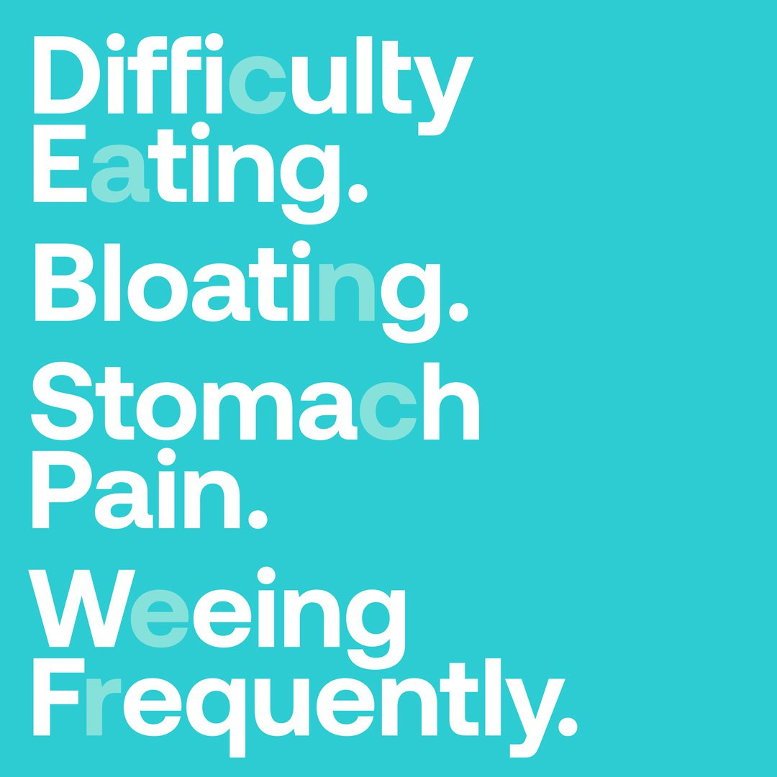
Main symptoms
If you’re suffering with any of these symptoms frequently, make sure you see your GP to rule out anything serious.

Slide 4
Frequent weeing

Slide 5
Difficulty eating

Slide 6
bloating

Slide 8
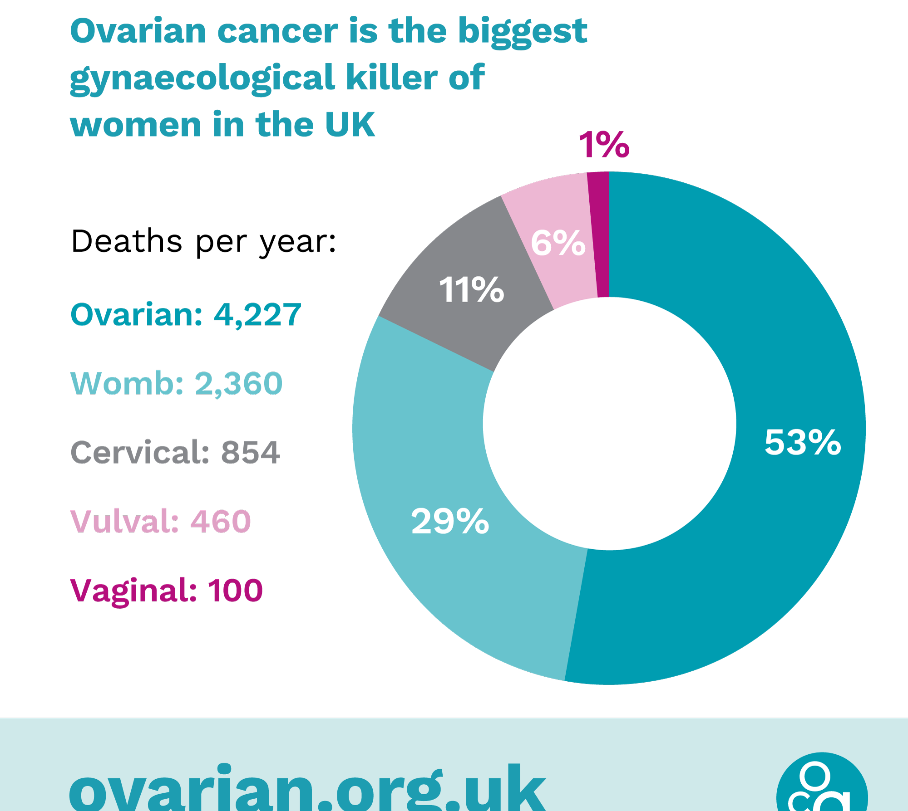
Biggest gynae killer
Ovarian cancer kills more women in the UK than womb, cervical, vaginal and vulval cancer combined.

Slide 9
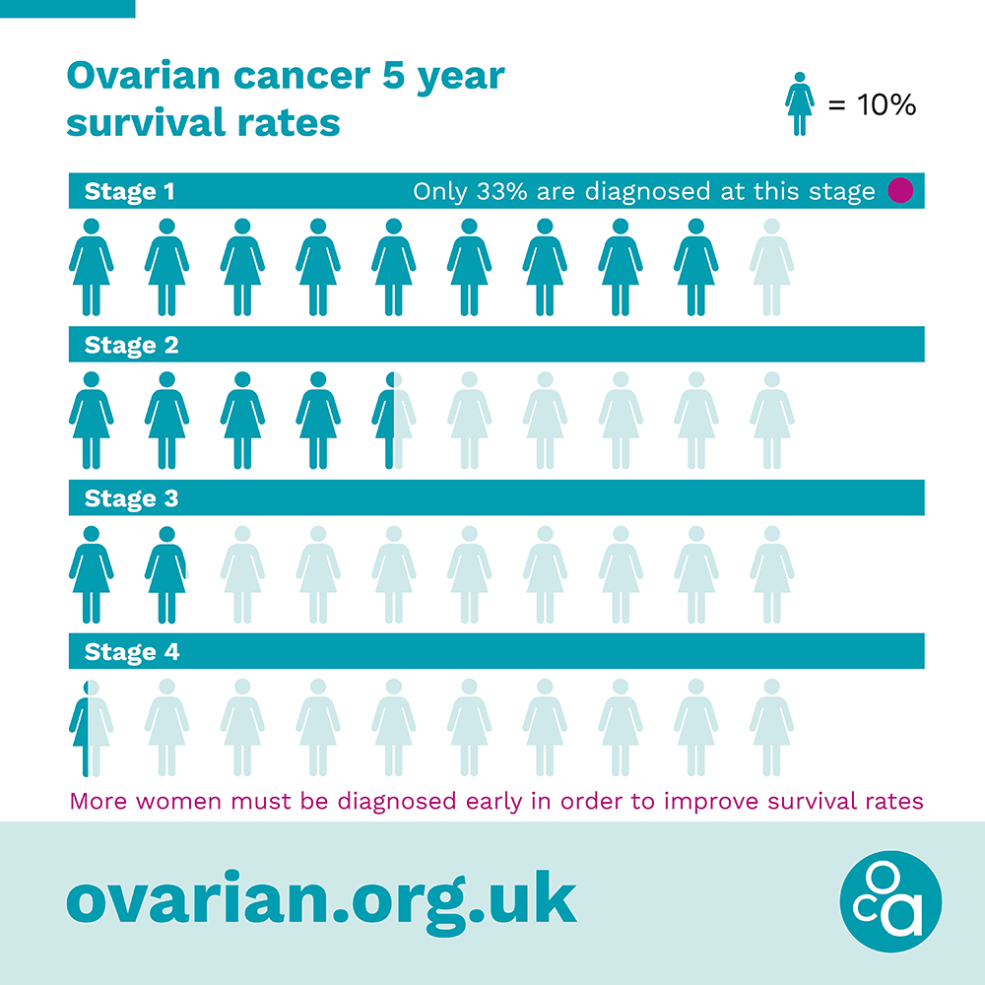
Early diagnosis is vital
Early diagnosis saves lives – ovarian.org.uk/symptoms

