Slide 2
TRIP
A SMART FAST TOOL TO FIND HIGH QUALITY CLINICAL RESEARCH EVIDENCE

Slide 3
What is Trip Database?
Trip is a clinical search engine designed to allow users to quickly and easily find and use high-quality research evidence to support their practice and/or care.
Trip has been online since 1997 and in that time has developed into the internet’s premier source of evidence-based content.

Slide 4
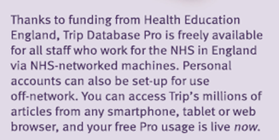

Slide 5
TRIP MEDICAL DATABASE

Slide 6
Do
a
PICO
search

Slide 7
