Slide 1
Calling all
Nurses!!

Slide 2
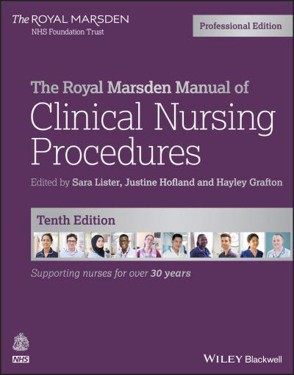
The Royal Marsden Manual of Clinical Nursing Procedures

Slide 3
The Manual is available..
..as a book you can borrow from the Library..
..or Online

Slide 4
To access online
To gain access you will need an OpenAthens password
Call in the library for help – or fill out the online form https://openathens.nice.org.uk/

Slide 5
Search the contents or search the A to Z

Slide 6
You can also search the chapters

Slide 7
You can also search the Procedures

Slide 8
Access..
..From the Library computers or any Trust computer

