Slide 1
Calling all nurses!
Online resources for your
patient care and research
Online resources for your
patient care and research

Slide 2
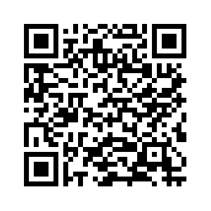
MAH Complete collection from MAG Online Library
The premium health journal collection from the Mark Allen Group.
www.magonlinelibrary.com/page/ collections/mahcomplete

Slide 3
MAH Complete covers the whole health care spectrum including nursing, midwifery, medicine, allied health professions and health economics.

Slide 4
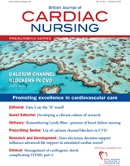
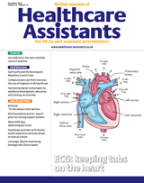
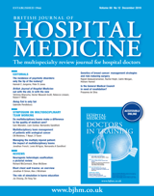
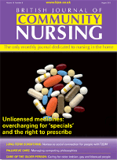
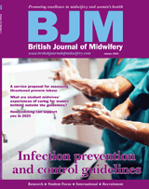
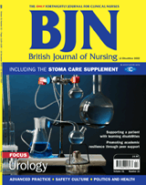
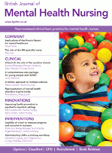
Access to Journals
MAH Complete has many journal titles for your patient care...

Slide 5
To gain access to the many articles you will need an OpenAthens password Call in the library for help – or fill out the online form https://openathens.nice.org.uk/

